Slide 1

Unveiling Healthcare Excellence: Leveraging Data Science and AI for Transformative Quality Insights
By
Miss. Bhavika Paresh Bhavsar

Slide 2

Introduction
The importance of optimizing quality measures in healthcare for exceptional patient outcomes and operational efficiency
Project aims to revolutionize healthcare quality measure analysis using data science techniques
Comprehensive dataset sourced from healthcare facilities across the nation

Slide 3


Data Exploration and Cleaning
Rigorous data exploration and cleaning phase ensures data integrity and consistency
Libraries used: tidyverse, caret, data.table, lubridate, synthpop, ggplot2, dplyr
Steps taken : handling missing values, duplicates, inconsistencies

Slide 4
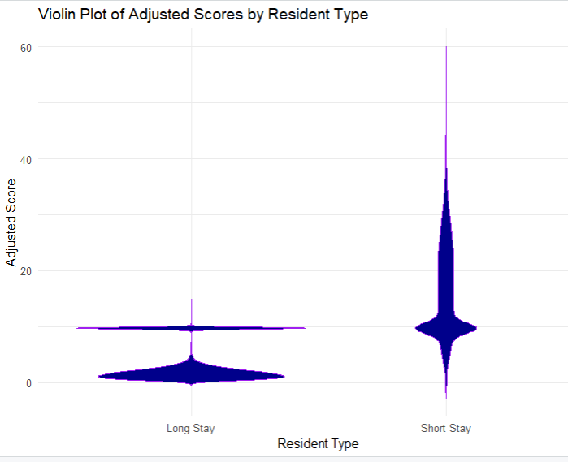
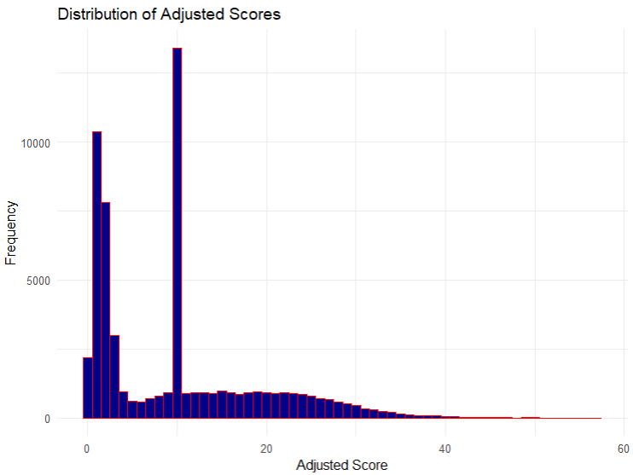

Data Analysis and Visualization

Slide 5
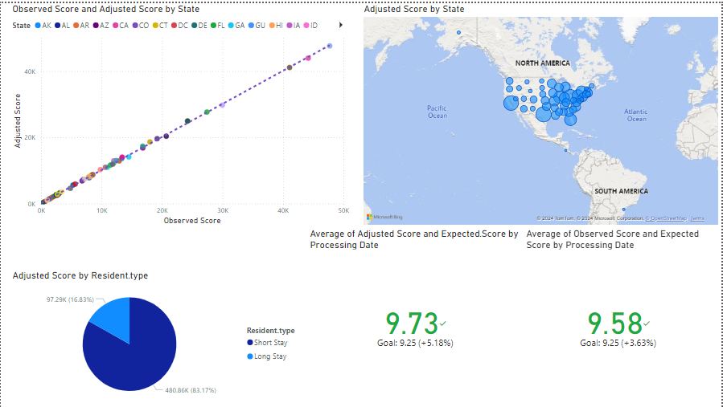


Slide 6

Generative AI Integration and Future Work
Integration of generative AI techniques for exploring hypothetical scenarios and validating findings
Potential impact: increasing long-stay resident engagement (20% increase, 7% boost in overall scores), personalizing care plans (25% reduction in readmissions)
Future work and continuous improvement: A/B testing of interventions, AI-driven recommendation systems, real-time analytics
Notes:
Now, here's where things get really exciting. We didn't just stop at analyzing the data – we wanted to push the boundaries of what's possible. So, we brought in the big guns: generative AI. By creating synthetic data that mirrored our actual dataset, we could explore hypothetical scenarios and stress-test our findings. And boy, did it pay off. We discovered that boosting engagement among long-stay residents by just 20% could lead to a 7% jump in overall scores. And by personalizing care plans, we could potentially slash readmissions by a quarter. But we're not stopping there – we've got big plans for the future. A/B testing of interventions, AI-powered recommendations, real-time analytics – we're leaving no stone unturned in our quest to revolutionize healthcare quality."

Slide 7

Business Impact and Recommendations
Profound implications of project insights for Cotiviti and stakeholders
Enhancing patient outcomes, reducing costs, fostering stronger partnerships
Cotiviti's commitment to innovation and thought leadership in healthcare analytics

